Slide 1

Computer Networks
COMPUTER NETWORKS
Piyush Narula (2022354) Aditya Aggrawal (2022028)

Slide 2
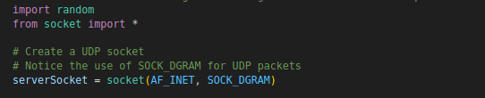

serverSocket = socket(AF_INET, SOCK_DGRAM)
UDPPINGERSERVER.PY
This line creates a UDP socket (SOCK_DGRAM is used for UDP as unlike to SOCK_STREAM for TCP).
The server binds the socket to a specific IP and port. An empty string ('') means it will bind to all available IP addresses on the host machine.

Slide 3
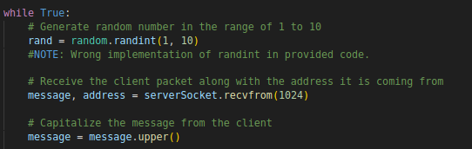
UDPPINGERSERVER.PY
The server runs indefinitely, waiting to receive messages. It generates a random number between 1 and 10 to simulate packet loss.
recvfrom(1024): Waits for a packet from a client and receives a maximum of 1024 bytes of data. address stores the client’s IP and port.

Slide 4
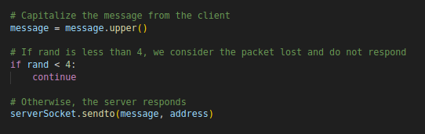
UDPPINGERSERVER.PY
message.upper() : Converts the message received from the client to uppercase as part of the response.
If the random number rand is less than 4 (i.e., 1, 2, or 3), the packet is considered "lost," and the server doesn't respond. If the packet is not "lost" (i.e., rand is 4 or higher), the server sends back the capitalized message to the client.

Slide 5

UDPPINGERCLIENT.PY
address: Sets the server’s address as 127.0.0.1 on port 12000.
settimeout(1): The client will wait a maximum of 1 second for a response. If no response is received within that time, a timeout occurs

Slide 6

UDPPINGERCLIENT.PY
A loop runs 10 times (since num_pings = 10), sending a ping each time.
send_time: Records the time just before sending the packet.
data: The ping message includes the ping number and the timestamp.

Slide 7
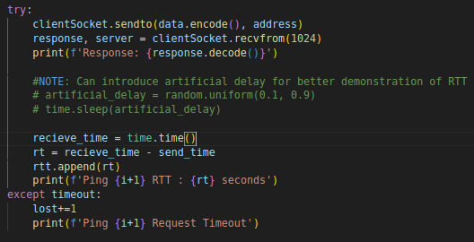
UDPPINGERCLIENT.PY
This sends the data to the server at the given address. The data.encode() method converts the string into bytes, which is necessary for UDP communication. This initiates the ping process.
The client waits for a response from the server using recvfrom(1024)
The recieve_time is captured right after receiving the server's response, and the RTT is calculated as the difference between recieve_time and send_time (the time the packet was sent).
If the client doesn’t receive a response within the specified timeout, a timeout exception is raised.

Slide 8
UDPPINGERCLIENT.PY
address: Sets the server’s address as 127.0.0.1 on port 12000.
settimeout(1): The client will wait a maximum of 1 second for a response. If no response is received within that time, a timeout occurs

Slide 9
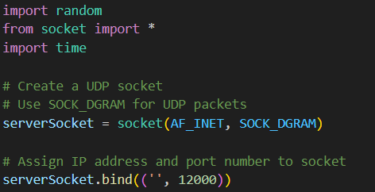
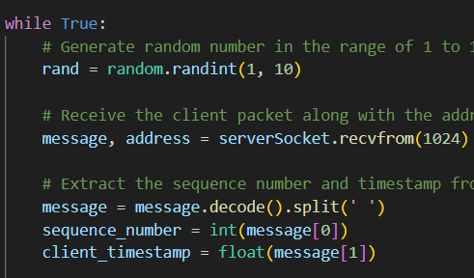
UDP HEARTBEAT SERVER
While True condition ensures that the server listens for messages indefinitely. The server socket obtains the encoded message and client address. The rand variable is used later for packet loss.
Import necessary libraries. Make a UDP connection by the server socket and bind it to port 12000. SOCK_DGRAM parameter ensures that the connection is UDP.

Slide 10
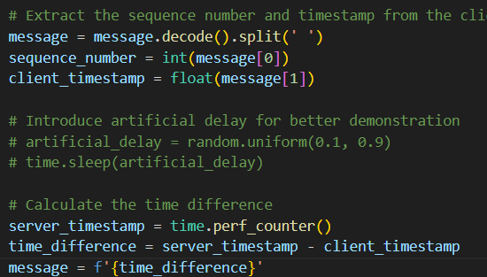
UDP HEARTBEAT SERVER
Decode the message
We expect a sequence number and a timestamp, separated by a space from the message. Thus, we perform a split on the decoded message.
Convert the sequence number to an integer and the timestamp to a floating number.
Capture the current timestamp with precision using perf_counter().
Calculate the time difference and store it in a message string.

Slide 11
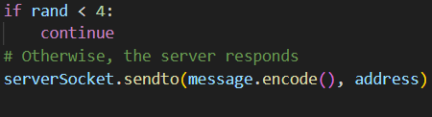
UDP HEARTBEAT SERVER
The rand variable is a randomly generated integer, which has a range of [0, 10].
If rand is less than 4, i.e., rand belongs to {1, 2, 3}, the message will not be sent, and the packet will be considered lost.
This happens with a rough probability of 30% as 3 out of 10 generated cases are conditioned to packet loss.
If not lost, the message is encoded and sent to client.

Slide 12
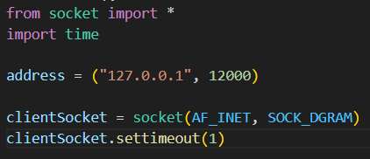
UDP HEARTBEAT CLIENT
Necessary imports are made.
The address and port number are specified. In the above screenshot, the IP address is set to the local machine.
Client Socket makes a connection. As previously described, SOCK_DGRAM ensures a UDP connection.
settimeout(1) ensures that after 1 second, the packet should be considered lost

Slide 13
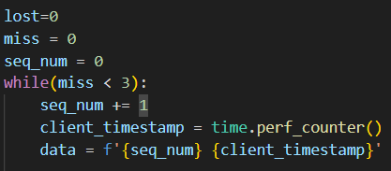
UDP HEARTBEAT CLIENT
lost variable keeps track of the number of messages that are lost, that is, the number of messages for which the client timed out.
miss variable keeps track of consecutively missed packets. If this number reaches 3, the client assumes the heartbeat is stopped and stops sending messages.
client timestamp stores the current timestamp on the client’s end.
data is the message string that is to be sent to the server. It contains the sequence number and the timestamp.

Slide 14
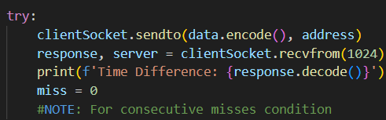
UDP HEARTBEAT CLIENT
Encode the data and send it to the server via the client socket.
Store the response and the server address received from the server.
Since we have received a message, the number of consecutive misses is set to zero (as we now have zero consecutive misses due to a hit).
The condition ‘miss = 0’ is only valid when the heartbeat stop condition is for the server to lose packet 3 times consecutively.
Print the decoded time difference on the client’s end.

Slide 15


UDP HEARTBEAT CLIENT
In case of a timeout, the program counter goes in the except block (error handling mechanism). Since a timeout refers to a packet loss, we increase the lost count and the miss count by 1. We also print the message that the request was timed out.
Show the number of packets that were sent, after which the program is terminated.
Also calculate and report the Packet Loss Rate percent.

